Slide 1
GITHUB REPOSITORIES

Slide 2
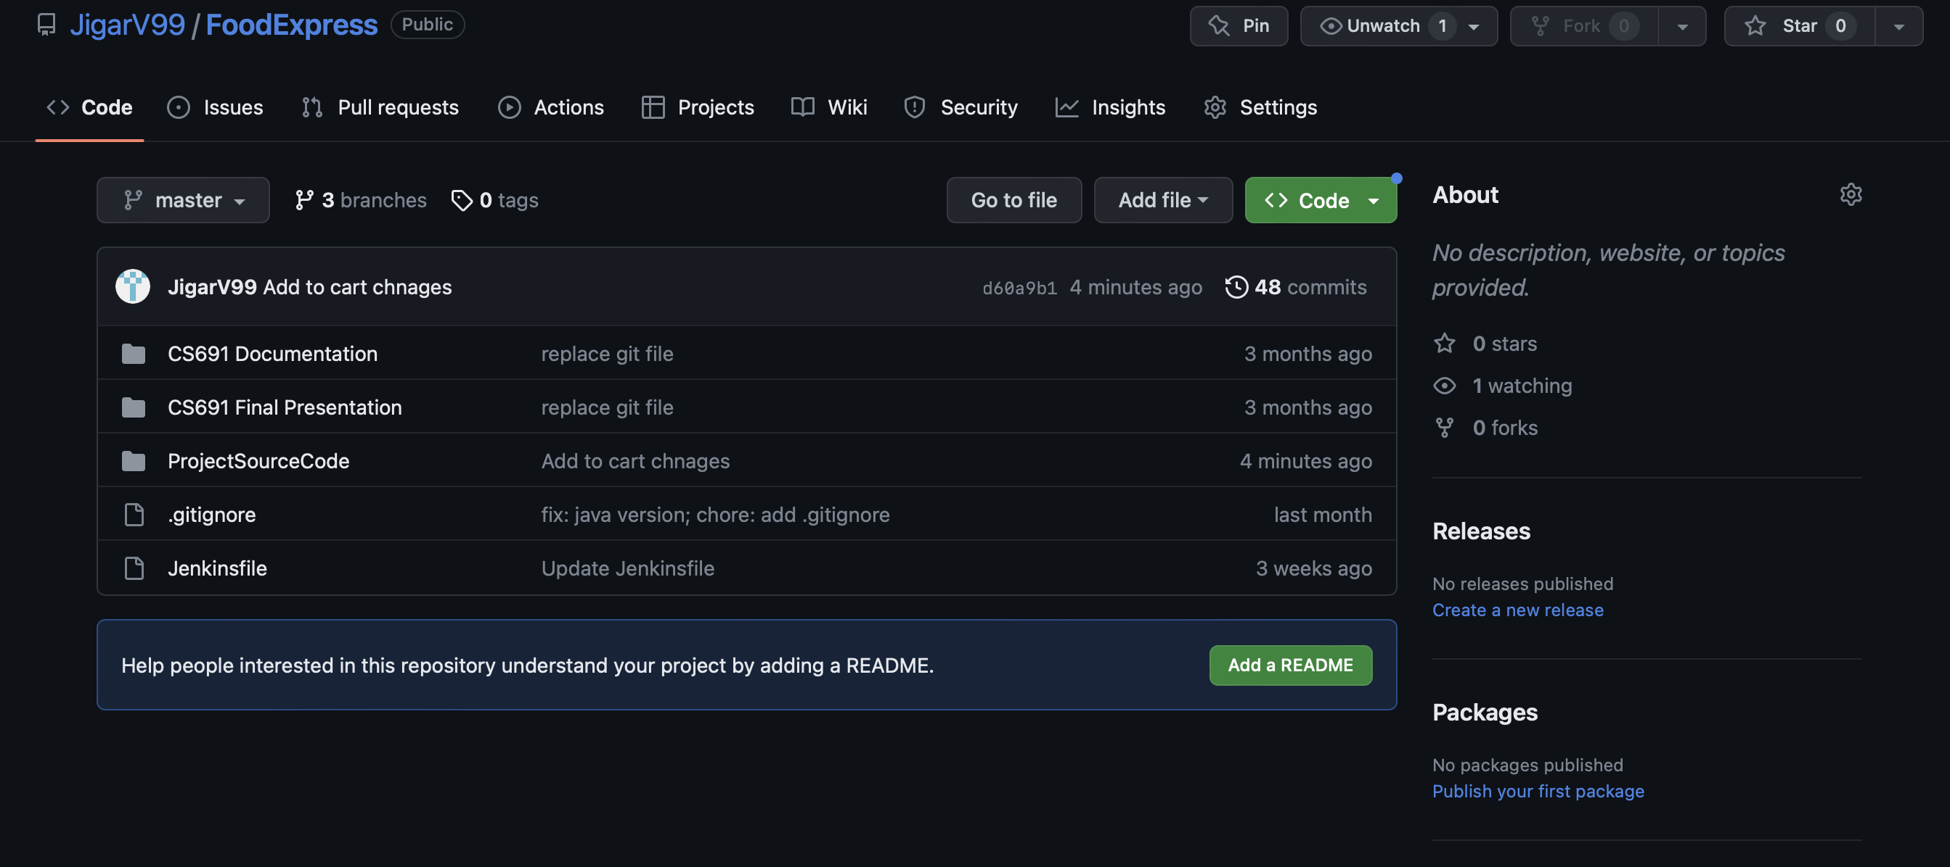
Github Link:
https://github.com/JigarV99/FoodExpress

Slide 3
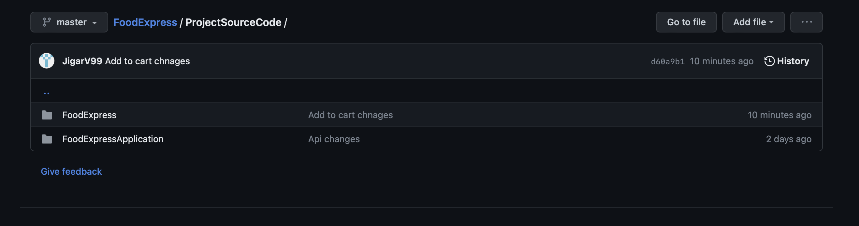
Front-end and Backend folder

Slide 4
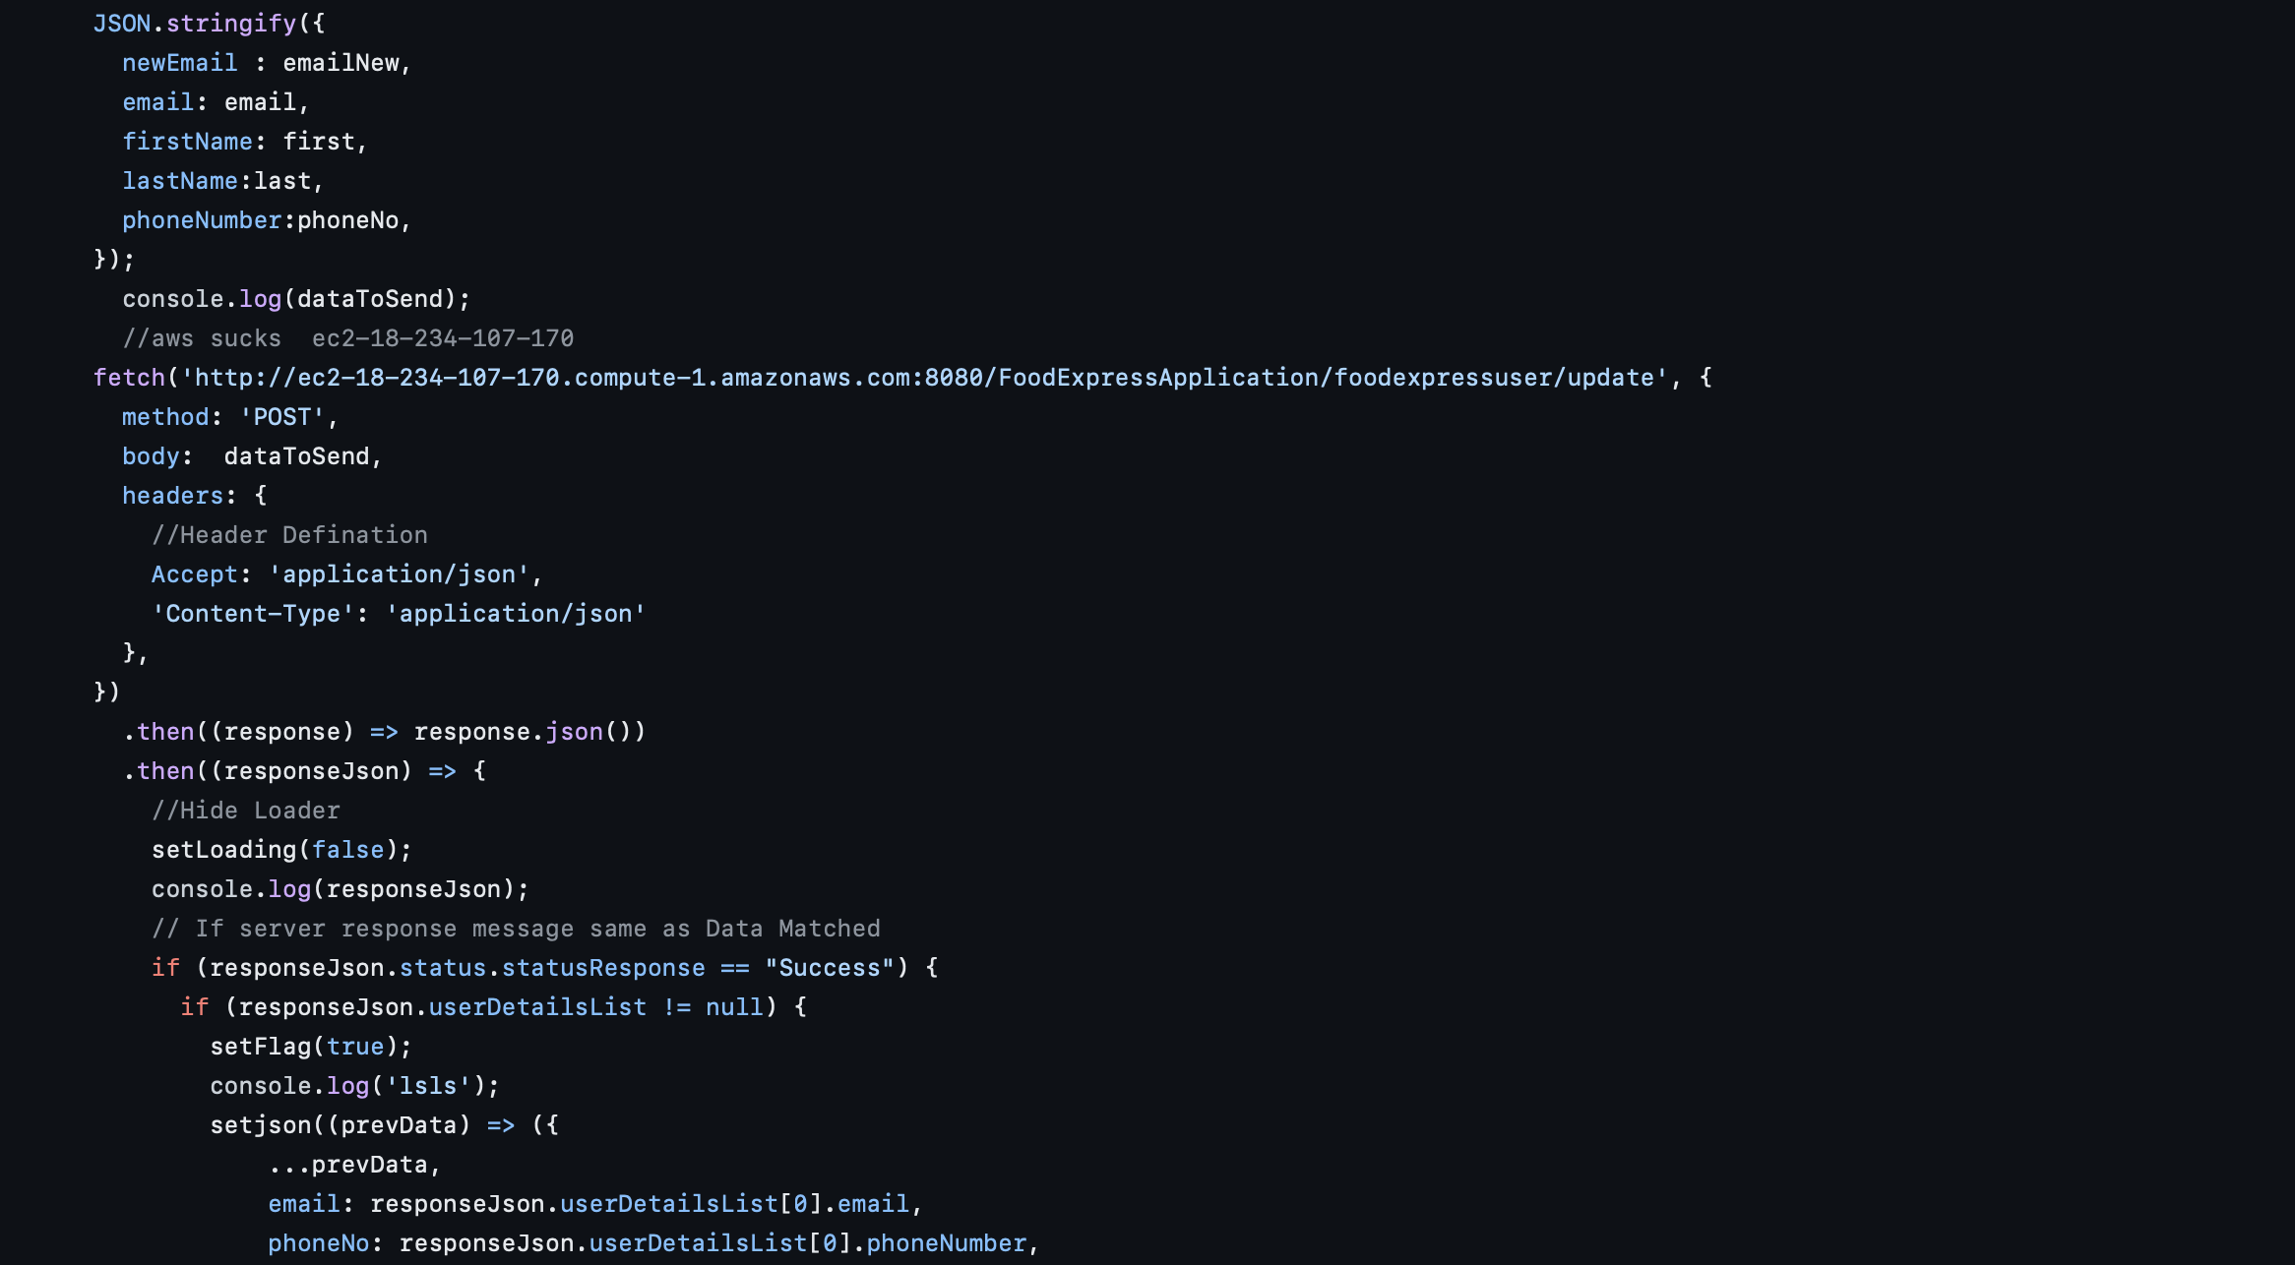
Front-end: Account Update code

Slide 5
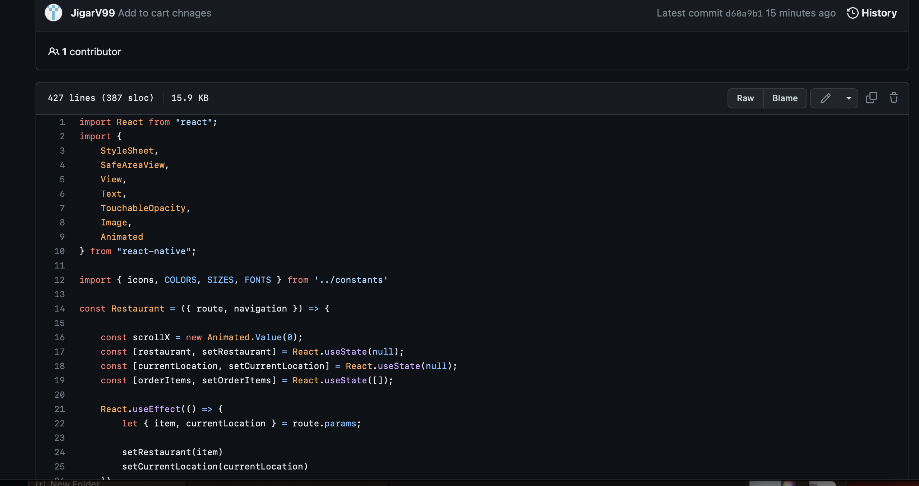
Front end: Add to Cart code

Slide 6
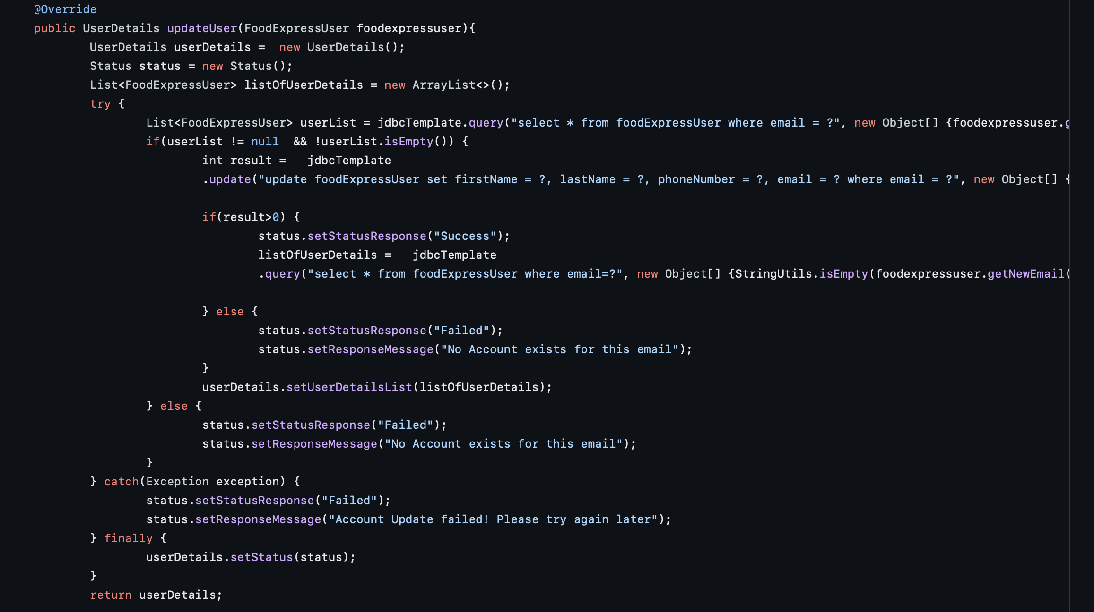
Backend Api

Slide 7
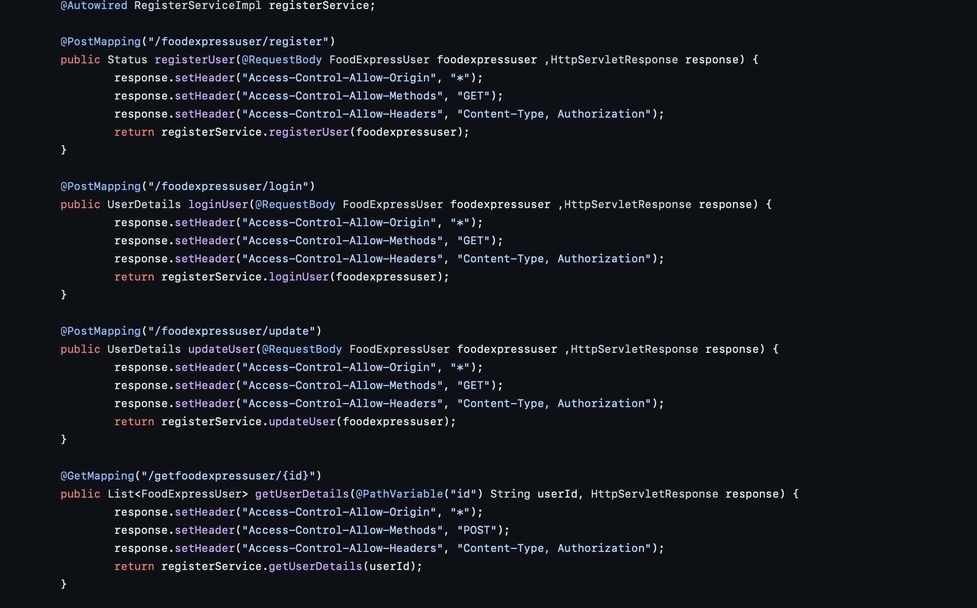
Backend

